Slide 1
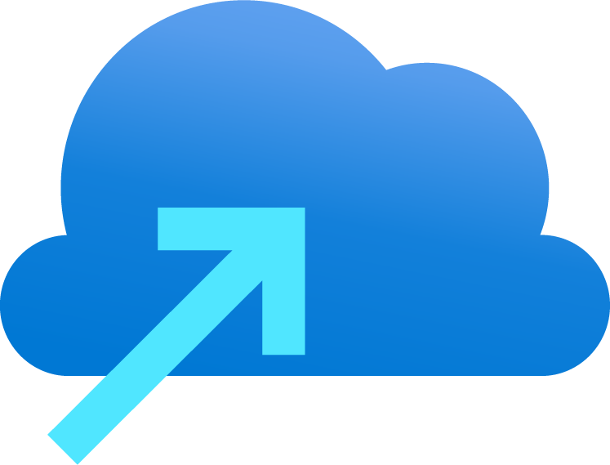
This document is provided “AS-IS,” WITHOUT WARRANTY OF ANY KIND. Microsoft disclaims all express, implied or statutory warranties, including warranties of quality, title, non-infringement, merchantability and fitness for a particular purpose. The information in this slide deck may be out of date however it contains information from the Cloud Adoption Framework which you should refer to - Microsoft Cloud Adoption Framework for Azure - Cloud Adoption Framework | Microsoft Docs

Slide 2
Azure Modern Service Operations Overview
Notes:
Why modern ops and what is different

Slide 3
Agenda
Journey
Operating model
Roles
Skilling
Azure Service Health – Incident Management
Cost Management
SLA and resilience
Azure Updates

Slide 4





What are your priorities right now?
Adoption Challenge/Priority | CAF Pillar | Suggested Starting Point
We want to build new products and services in the cloud | Innovate | Getting started
We want to migrate existing workloads (Apps, data, and VMs) to the cloud | Migrate | Getting started
Digital transformation is hard, where do we start | Strategy | Getting started
We want to align our organization to ensure success in the cloud | Organize | Team Structure
We want to a simple organization structure that will help us get started | Plan | Initial Org Alignment
We need a clear action plan to guide our efforts | Plan | Cloud Adoption Plan
We are getting blocked by outdated processes and on-prem thinking | Organize | Team Structure and Central IT Risks
We don't know which controls, compliance, or governance components are needed in our environment | Govern | Governance Benchmark Assessment
We need to start implementing controls, compliance, or governance | Govern | Getting started and Initial governance foundation
We are blocked by environment design and configuration | Ready | Set up Guide and Landing Zone
Our people don't have the technical skills to adopt the cloud | Plan | Skills readiness plan
We are blocked by security concerns | Govern | Initial governance foundation and Improve your security baseline
We need help managing resources and controlling costs | Govern | Initial governance foundation, Improve resource consistency, & Improve cost management
We need a fast way to configure our Azure environment | Ready | Landing zone blueprint
We need help understanding how to manage and operate our cloud environment | Manage | Getting started

Slide 5
Today’s Cloud Challenges
Azure governance building blocks?
Which services should be migrated to Azure?
What are the core processes needed for service management?
What security measures should I consider?
What roles & responsibilities I must define?
Ensure Cloud Resource Usage Optimization Across Team?
How do I ensure a balance between innovation, cost and agility?
Who is responsible for monitoring? support? And operations?
What key capabilities I must develop?

Slide 6
Modern Service Operations Journey Map
Transition processes
Review and map new roles
Understand Cloud Functions
Review existing processes
Team structure and RACI
Provide role transition support
Choose your Cloud operating Model
Build skills plans
Map people to functions
Team alignment to Organisation
Organisational priorities and scope
Organisational alignment
Team structures and skilling
Transition People, process and technology to provide business outcomes
Identify training/skilling resources
Using proven practical guidance from the Cloud Adoption and Well Architected Frameworks
Notes:
Modernisation is more than just having the right architecture or a secure infrastructure. It is about aligning business, people and technology strategies to achieve business goals with actionable, efficient, and comprehensive guidance to deliver fast results with control and stability. Modernisation is about culture change and adoption of modern processes and practices too!!
Establish policy adherence processes - Cloud Adoption Framework | Microsoft Docs

Slide 7

Cloud Operating Model

Slide 8
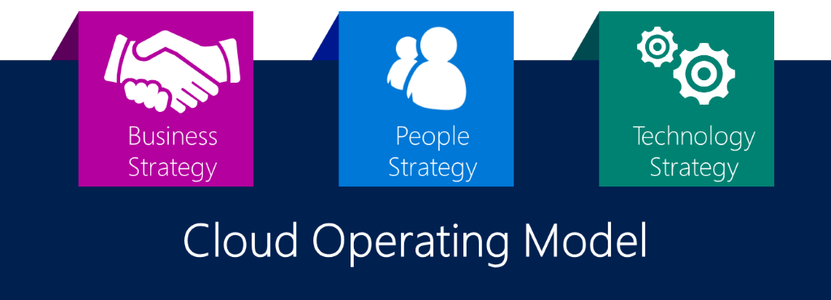
Why looking at a Cloud Operating Model?
A cloud operating model is the collection of processes and procedures that define how you want to operate technology in the cloud.
Microsoft Azure Well-Architected Framework - Microsoft Azure Well-Architected Framework introduction | Microsoft Docs

Slide 9
Cloud Operating Models Questions
What is an operating model? - A cloud operating model is the collection of processes and procedures that define how you want to operate technology in the cloud.
How will you manage and operate workloads in the cloud. Current focus is on physical location with physical assets
How is a cloud operating model different?
Breaks never ending hardware fix, replace, renew cycle
Higher level of operations – Security no longer within walls of your DC – threat profile changes.
Procurement is no longer a blocker – rate of change need to be managed
Purpose of a cloud operating model?
focus shifts to the digital assets and the workloads they support
Reimagine your operating model and how the Cloud Adoption Framework helps you define your operating model?
Notes:
Adopting the cloud creates an opportunity to revisit how you operate technology systems. This article series will clarify cloud operating models and the considerations that impact your cloud adoption strategy. But first, let's clarify the term cloud operating model.
Define your operating model
Before deploying your cloud architecture, it's important to understand how you want to operate in the cloud. Understanding your strategic direction, people organization, and governance, risk, and compliance (GRC) needs helps define your future state cloud operating model. Then, Azure landing zones can provide a variety of architecture and implementation options to support your operating model. The next few articles will share a few foundational terms and provide examples of common operating models based on actual customer experiences, which together can guide your decision about the right Azure landing zone to implement.
What is an operating model?
Prior to the existence of cloud technologies, technology teams established operating models to define how technology would support the business. Any company's IT operating model has a number of factors, but a few remain consistent: alignment to business strategy, organization of people, change management (or adoption processes), operations management, governance/compliance, and security. Each factor is essential to long-term technology operations.
When technology operations shift to the cloud, these vital processes are still relevant, but they're likely to change in some ways. Current operating models focus heavily on physical assets in physical locations funded largely through capital expenditure cycles. These assets are used to support the workloads that the business needs to maintain business operations. The mission of most operating models is to prioritize stability of the workloads by investing in the stability of the underlying physical assets.
How is a cloud operating model different?
Redundancy in the hardware stack is a never-ending cycle. Physical hardware breaks down. Performance degrades. The degradation of hardware rarely aligns with the predictable budgetary cycles of an organization's capital expenditure planning cycles. Operating in the cloud breaks the treadmill of hardware refreshes and midnight patches by shifting the focus upstream to the digital assets: operating systems, applications, and data. This shift from physical to digital also shifts the technology operating model.
As your operating model shifts to the cloud, you still need the same people and processes, but they also shift to focus on a higher level of operations. If your people no longer focus on server uptime, then their success metrics will change. If security is no longer protected by the four walls of a datacenter, then your threat profile changes. When procurement is no longer a blocker to innovation, then the pace at which you manage change also changes.
A cloud operating model is the collection of processes and procedures that define how you want to operate technology in the cloud.
Purpose of a cloud operating model
When hardware is removed as the most common unit of operations, the focus shifts to the digital assets and the workloads they support. As such, the purpose of the operating model shifts from keeping the lights on to ensuring consistent operations.
The Microsoft Azure Well-Architected Framework does a great job of decomposing workload considerations into a set of common architectural principles: cost optimization, operational excellence, performance efficiency, reliability, and security.
When moving to a higher level of operations, these common architectural principles help reframe the purpose of the cloud operating model. How do we ensure that all assets and workloads in the portfolio balance these architecture principles? What processes are needed to scale the application of those principles?
Reimagine your operating model
If you updated your operating model to remove every reference to the procurement, change, operations, or protection of physical assets, what's left? For some organizations, their operating model is now a clean slate. For most organizations, the constraints that have developed over the years are now reduced. In either case, there is an opportunity to think about how you would like to operate in the cloud.
To help you imagine your future state operating model, these articles discuss the following subjects:
Define your cloud operating model
Compare common cloud operating models
Implement your operating model with Azure landing zones
Next steps
Learn how the Cloud Adoption Framework helps you define your operating model
https://docs.microsoft.com/en-us/azure/cloud-adoption-framework/operating-model/

Slide 10
Purpose of the Cloud Operating Model
Shifting from keeping the lights on to ensuring consistent operations.
Decomposing workload considerations into a set of common architectural principles
Well-Architected Framework
Pillar | Description
Cost Optimization | Managing costs to maximize the value delivered.
Operational Excellence | Operations processes that keep a system running in production.
Performance Efficiency | The ability of a system to adapt to changes in load.
Reliability | The ability of a system to recover from failures and continue to function.
Security | Protecting applications and data from threats.
What processes are needed to scale the application of these principles
Notes:
When hardware is removed as the most common unit of operations, the focus shifts to the digital assets and the workloads they support. As such, the purpose of the operating model shifts from keeping the lights on to ensuring consistent operations.
The Microsoft Azure Well-Architected Framework does a great job of decomposing workload considerations into a set of common architectural principles: cost optimization, operational excellence, performance efficiency, reliability, and security.
When moving to a higher level of operations, these common architectural principles help reframe the purpose of the cloud operating model. How do we ensure that all assets and workloads in the portfolio balance these architecture principles? What processes are needed to scale the application of those principles?
Cloud operating models are complex. Countless customers become blocked by minor details while defining their cloud operating model. It's easy to fall into a series of circular references. To avoid circular references, the Cloud Adoption Framework provides a series of complimentary and incremental methodologies that decompose the volume of decisions into smaller exercises.
Cloud Adoption Framework alignment
To help you define the cloud operating model for your business, the Cloud Adoption Framework breaks down each aspect of the operating model into methodologies. Each methodology and the associated actionable exercises are designed to help you define your future state operations.
The following areas of the Cloud Adoption Framework are incremental methodologies designed to help grow areas of your operating model.
Manage: Align ongoing processes for operational management of the technology to maximize value attainment and minimize disruptions.
Govern: Ensure consistency across adoption efforts. Align to governance or compliance requirements to maintain a cross-cloud environment.
Security strategy: Help for defining your overall security strategy.
Organize: Outlines the functions needed in the cloud. Also defines ways to organize people and align responsibilities.

Slide 11
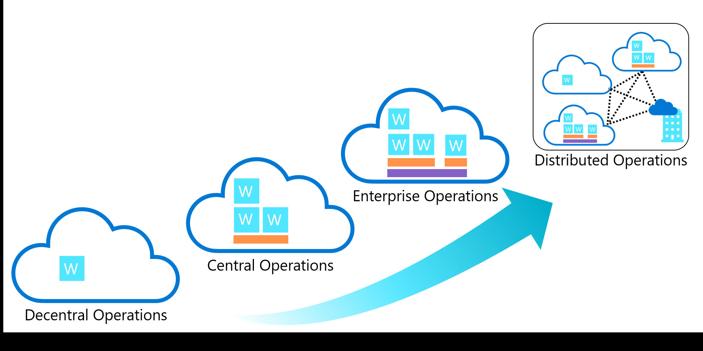
Compare Common Operating Models
A cloud operating model is primarily driven by two factors:
Strategic priorities and motivations.
The scope of the portfolio to be managed.
Notes:
Operating models are unique and specific to the business they support, based on their current requirements and constraints. But, this uniqueness shouldn't suggest that operating models are snowflakes. There are a few common patterns of customer operating models. This article outlines the four most common patterns.
This image maps common operating models based on the range of complexity, from least complex (decentralized) to most complex (global operations).
Strategic priorities or motivations: Each operating model is capable of delivering the typical strategic motivations for cloud adoption. However, some operating models simplify realizing specific motivations.
Portfolio scope: The portfolio scope row below identifies the largest scope that a specific operating model is designed to support. For example, centralized operations is designed for a small number of landing zones. But that operating model decision could inject operational risks for an organization that's trying to manage a large, complex portfolio that might require many landing zones or variable complexity in landing zone design.
Next we will compare these same operating models based on relative value of a few other attributes.
https://docs.microsoft.com/en-us/azure/cloud-adoption-framework/operating-model/compare
Motivations
Business transformations that are supported by cloud adoption can be driven by various motivations. It's likely that several motivations apply at the same time. The goal of the lists in the following table is to help generate ideas about which motivations are relevant. From there, you can prioritize and assess the potential impacts of the motivations. In this article, your cloud adoption team should meet with various executives and business leaders using the list below to understand which of these motivations are affected by the cloud adoption effort.
Critical business events
Datacenter exit Merger, acquisition, or divestiture Reduction in capital expenses End of support for mission-critical technologies Response to regulatory compliance changes New data sovereignty requirements Reduction of disruptions and improvement of IT stability Reduce carbon footprint Migration
The migration motivations listed near the top of the motivations table are the most common, but not necessarily the most significant, reasons for adopting the cloud. These outcomes are important to achieve, but they're most effectively used to transition to other, more useful worldviews. This important first step to cloud adoption is often called a cloud migration. The framework refers to the strategy for executing a cloud migration by using the term migrate.
Some motivations align well with a migrate strategy. The motives at the top of this list will likely have significantly less business impact than those toward the bottom of the list.
Cost savings Reduction in vendor or technical complexity Optimization of internal operations Increase in business agility Preparation for new technical capabilities Scaling to meet market demands Scaling to meet geographic demands Integration of a complex it portfolio Innovation
Data is the new commodity. Modern applications are the supply chain that drives that data into various experiences. In today's business market, it's hard to find a transformative product or service that isn't built on top of data, insights, and customer experiences. The motivations that appear lower in the innovation list align to a technology strategy referred to in this framework as the Innovate methodology.
The following list includes motivations that cause an IT organization to focus more on an innovate strategy than a migrate strategy.
Increasing business agility.
Preparing for new technical capabilities.
Building new technical capabilities.
Scaling to meet market demands.
Scaling to meet geographic demands.
Improving customer experiences and engagements.
Transforming products or services.
Preparation for new technical capabilities Building new technical capabilities Scaling to meet market demands Scaling to meet geographic demands Improved customer experiences and engagements Transformation of products or services Market disruption with new products or services Democratization and/or self-service environments

Slide 12
Priorities and Scope
 | Decentralized operations (ops) | Centralized operations (ops) | Enterprise operations (ops) | Distributed operations (ops)
Strategic priority | Innovation | Control | Democratization | Integration
Portfolio scope | Workload | Landing zone | Cloud platform | Full portfolio
Workload environment | High complexity | Low complexity | Medium complexity | Medium or variable complexity
Landing zone | N/A | High complexity | Medium to low complexity | Low complexity
Foundation utilities | N/A | N/A or low support | Centralized and more support | Most support
Cloud foundation | N/A | N/A | Hybrid, provider specific, or regional foundations | Distributed and synchronized
Notes:
cloud operating model is primarily driven by two factors:
Strategic priorities and motivations.
The scope of the portfolio to be managed.
Strategic priorities or motivations: Each operating model is capable of delivering the typical strategic motivations for cloud adoption. However, some operating models simplify realizing specific motivations.
Portfolio scope: The portfolio scope row below identifies the largest scope that a specific operating model is designed to support. For example, centralized operations is designed for a small number of landing zones. But that operating model decision could inject operational risks for an organization that's trying to manage a large, complex portfolio that might require many landing zones or variable complexity in landing zone design.

Slide 13
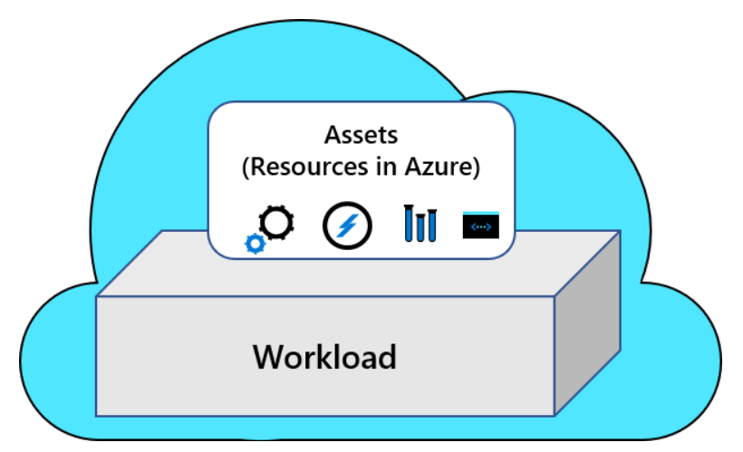
Decentralized operations (Option 1)
Notes:
Operations is always complex. By limiting the scope of operations to one workload or a small collection of workloads, that complexity can be controlled. As such, decentralized operations is the least complex of the common operating models. In this form of operations, all workloads are operated independently by dedicated workload teams.
Priorities: Innovation is prioritized over centralized control or standardization across multiple workloads.
Distinct advantage: Maximizes speed of innovation by placing workload and business teams in full control of design, build, and operations.
Distinct disadvantage: Reduction in cross-workload standardization, economies of scale through shared services, and consistent governance centralized compliance efforts.
Risk: This approach introduces risk when managing a portfolio of workloads. Since the workload team is less likely to have specialized teams dedicated to central IT functions, this operating model is viewed as a high risk option by some organizations, especially companies that are required to follow third-party compliance requirements.

Slide 14
Decentralized operations
Priorities: Innovation
Distinct advantage:
Speed of innovation – full control of design, build, and operations with workload and business teams
Distinct disadvantage: Reduction in cross-workload standardization, economies of scale through shared services, and consistent governance centralized compliance efforts.
Risk: This approach is viewed as a high-risk option by some organizations, especially companies that are required to follow third-party compliance requirements.
Notes:
Operations is always complex. By limiting the scope of operations to one workload or a small collection of workloads, that complexity can be controlled. As such, decentralized operations is the least complex of the common operating models. In this form of operations, all workloads are operated independently by dedicated workload teams.
Priorities: Innovation is prioritized over centralized control or standardization across multiple workloads.
Distinct advantage: Maximizes speed of innovation by placing workload and business teams in full control of design, build, and operations.
Distinct disadvantage: Reduction in cross-workload standardization, economies of scale through shared services, and consistent governance centralized compliance efforts.
Risk: This approach introduces risk when managing a portfolio of workloads. Since the workload team is less likely to have specialized teams dedicated to central IT functions, this operating model is viewed as a high-risk option by some organizations, especially companies that are required to follow third-party compliance requirements.

Slide 15
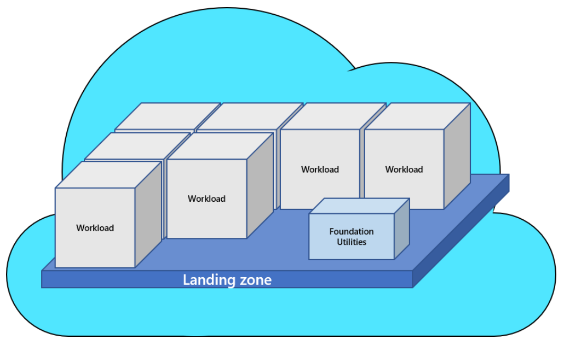
Centralized operations (Option 2)
Notes:
Stable state environments might not require as much focus on the architecture or distinct operational requirements of the individual workloads. Central operations tend to be the norm for technology environments that consist primarily of stable-state workloads. Examples of a stable-state of operations include things like commercial-off-the-shelf (COTS) applications or well-established custom applications that have a slow release cadence. When rate of change is driven by a regular drumbeat of updates and patches (over the high change rate of innovation), centralization of operations is an effective means to manage the portfolio.
Priorities: Prioritizes central control over innovation. Also prioritizes continuation of existing operational processes over cultural shift to modern cloud operations options.
Distinct advantage: Centralization introduces economies of scale, best-of-breed controls, and standardized operations. This approach works best with the cloud environment needs specific configurations integrate cloud operations into existing operations and processes. This approach is most advantageous to centralized teams with a portfolio of a few hundred workloads with modest architectural complexity and compliance requirements.
Distinct disadvantage: Scaling to meet the demands of a large portfolio of workloads can place significant strain on a centralized team making operational decisions for production workloads. If technical assets are expected to scale beyond 1,000 or so VMs, applications, or data sources in the cloud within the next 18-24 months, an enterprise model should be considered.
Risk: This approach limits centralization to a smaller number of subscriptions (often one production subscription). There is a risk of significant refactoring later in the cloud journey that could interfere with adoption plans. Specifically, care should be given to segmentation, environment boundaries, identity tooling, and other foundational elements to avoid significant rework in the future.

Slide 16
Centralized operations
Priorities: Prioritizes central control over innovation. Existing operational processes over cultural shift to modern cloud operations.
Distinct advantage:
Economies of scale, best-of-breed controls, and standardized operations.
Most advantageous to centralized teams with a portfolio of a few hundred workloads with modest architectural complexity and compliance requirements.
Distinct disadvantage: Scaling to meet the demands of a large portfolio of workloads can place significant strain on a centralized team making operational decisions for production workloads.
If technical assets are expected to scale beyond 1,000 or so VMs, applications, or data sources within the next 18-24 months, an enterprise model should be considered.
Risk: This approach limits centralization to a smaller number of subscriptions (often one production subscription). There is a risk of significant refactoring later in the cloud journey that could interfere with adoption plans.
Notes:
Stable state environments might not require as much focus on the architecture or distinct operational requirements of the individual workloads. Central operations tend to be the norm for technology environments that consist primarily of stable-state workloads. Examples of a stable-state of operations include things like commercial-off-the-shelf (COTS) applications or well-established custom applications that have a slow-release cadence. When rate of change is driven by a regular drumbeat of updates and patches (over the high change rate of innovation), centralization of operations is an effective means to manage the portfolio.
Priorities: Prioritizes central control over innovation. Also prioritizes continuation of existing operational processes over cultural shift to modern cloud operations options.
Distinct advantage: Centralization introduces economies of scale, best-of-breed controls, and standardized operations. This approach works best with the cloud environment needs specific configurations integrate cloud operations into existing operations and processes. This approach is most advantageous to centralized teams with a portfolio of a few hundred workloads with modest architectural complexity and compliance requirements.
Distinct disadvantage: Scaling to meet the demands of a large portfolio of workloads can place significant strain on a centralized team making operational decisions for production workloads. If technical assets are expected to scale beyond 1,000 or so VMs, applications, or data sources in the cloud within the next 18-24 months, an enterprise model should be considered.
Risk: This approach limits centralization to a smaller number of subscriptions (often one production subscription). There is a risk of significant refactoring later in the cloud journey that could interfere with adoption plans. Specifically, care should be given to segmentation, environment boundaries, identity tooling, and other foundational elements to avoid significant rework in the future.

Slide 17
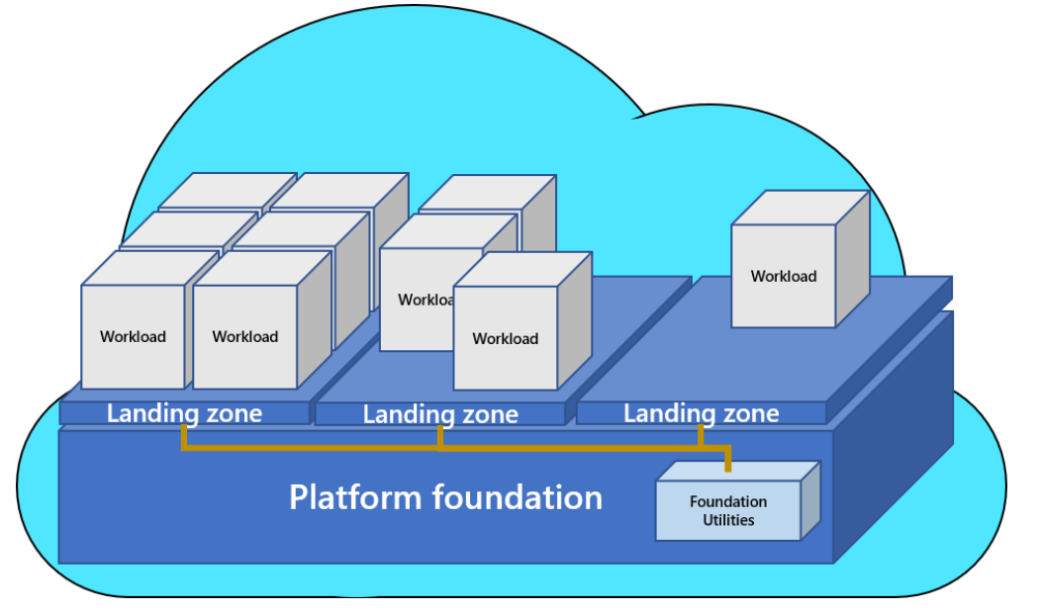
Enterprise operations (Option 3)
Notes:
Enterprise operations is the suggested target state for all cloud operations. Enterprise operations balances the need for control and innovation by democratizing decisions and responsibilities. Central IT is replaced by a more facilitative cloud center of excellence or CCoE team, which supports workload teams and hold them accountable for decisions, as opposed to controlling or limiting their actions. Workload teams are granted more power and more responsibility to drive innovation, within well-defined guardrails.
Priorities: Prioritizes democratization of technical decisions. Democratization of technical decisions shifts responsibilities previously held by central IT to workload teams when applicable. To deliver this shift in priorities, decisions become less dependent on human-run review processes and more dependent on automated review, governance, and enforcement using cloud-native tools.
Distinct advantage: Segmentation of environments and separation of duties allow for balance between control and innovation. Central operations can maintain centralized operations for workloads that require increase compliance, stable state operations, or represent greater security risks. Conversely, this approach allows for reduction in centralized control of workloads and environments that require greater innovation. Since larger portfolios are more likely to struggle with the balance between control and innovation, this flexibility makes it easier to scale to thousands of workloads with reductions in operational pains.
Distinct disadvantage: What worked well on-premises might not work well in enterprise cloud operations. This approach to operations requires changes on many fronts. Cultural shifts in control and responsibility are often the biggest challenge. Operational shifts that follow the cultural shift take time and committed effort to implement, mature, and stabilize. Architectural shifts are sometimes required in otherwise stable workloads. Tooling shifts are required to empower and support the cultural, operational, and architectural shifts, which might require commitments to a primary cloud provider. Adoption efforts made prior to these changes might require significant rework that goes beyond typical refactoring efforts.
Risk: This approach requires executive commitment to the change strategy. It also requires commitment from the technical teams to overcome learning curves and deliver the required change. Long-term cooperation between business, CCoE/central IT, and workload teams is required to see long-term benefits.

Slide 18
Enterprise operations
Priorities: Prioritizes democratization of technical decisions. Democratization of technical decisions shifts responsibilities previously held by central IT to workload teams when applicable.
Distinct advantage: Segmentation of environments and separation of duties allow for balance between control and innovation. Central operations can maintain centralized operations for workloads that require increase compliance, stable state operations, or represent greater security risks. Distinct disadvantage: What worked well on-premises might not work well in enterprise cloud operations. Cultural shifts in control and responsibility are often the biggest challenge. Operational shifts that follow the cultural shift take time and committed effort to implement, mature, and stabilize. Risk: This approach requires executive commitment to the change strategy. It also requires commitment from the technical teams to overcome learning curves and deliver the required change. Long-term cooperation between business, CCoE/central IT, and workload teams is required to see long-term benefits.
Notes:
Enterprise operations is the suggested target state for all cloud operations. Enterprise operations balances the need for control and innovation by democratizing decisions and responsibilities. Central IT is replaced by a more facilitative cloud center of excellence or CCoE team, which supports workload teams and hold them accountable for decisions, as opposed to controlling or limiting their actions. Workload teams are granted more power and more responsibility to drive innovation, within well-defined guardrails.
Priorities: Prioritizes democratization of technical decisions. Democratization of technical decisions shifts responsibilities previously held by central IT to workload teams when applicable. To deliver this shift in priorities, decisions become less dependent on human-run review processes and more dependent on automated review, governance, and enforcement using cloud-native tools.
Distinct advantage: Segmentation of environments and separation of duties allow for balance between control and innovation. Central operations can maintain centralized operations for workloads that require increase compliance, stable state operations, or represent greater security risks. Conversely, this approach allows for reduction in centralized control of workloads and environments that require greater innovation. Since larger portfolios are more likely to struggle with the balance between control and innovation, this flexibility makes it easier to scale to thousands of workloads with reductions in operational pains.
Distinct disadvantage: What worked well on-premises might not work well in enterprise cloud operations. This approach to operations requires changes on many fronts. Cultural shifts in control and responsibility are often the biggest challenge. Operational shifts that follow the cultural shift take time and committed effort to implement, mature, and stabilize. Architectural shifts are sometimes required in otherwise stable workloads. Tooling shifts are required to empower and support the cultural, operational, and architectural shifts, which might require commitments to a primary cloud provider. Adoption efforts made prior to these changes might require significant rework that goes beyond typical refactoring efforts.
Risk: This approach requires executive commitment to the change strategy. It also requires commitment from the technical teams to overcome learning curves and deliver the required change. Long-term cooperation between business, CCoE/central IT, and workload teams is required to see long-term benefits.

Slide 19
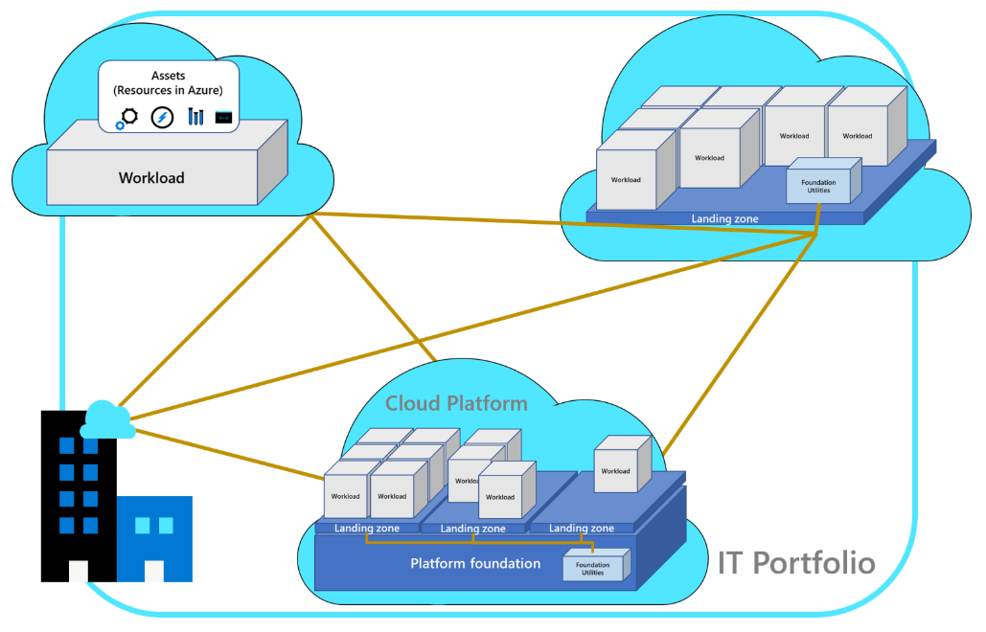
Distributed operations (Option 4)
Notes:
The existing operating model might be too engrained for the entire organization to shift to a new operating model. For others, global operations and various compliance requirements might prevent specific business units from making a change. For those companies, a distributing operations approach might be required. This is by far the most complex approach, as it requires an integration of one or more of the previously mentioned operating models.
While heavily discouraged, this approach to operations might be required for some organizations who consist of a loose collection of disparate business units. Especially when those business units span a diverse base of customer segments or regional operations.
Priorities: Integration of multiple existing operating models.
Transitional state with a focus on moving the entire organization to one of the previously mentioned operating models, over time.
Longer term operational approach when the organization is too large or too complex to align to a single operating model.
Distinct advantage: Integration of common operating model elements from each business unit. Creates a vehicle to group operating units into a hierarchy and help them mature operations using consistent repeatable processes.
Distinct disadvantage: Consistency and standardization across multiple operating models is difficult to maintain for extended periods. This operational approach requires deep awareness of the portfolio and how various segments of the technology portfolio are operated.
Risk: Lack of commitment to a primary operating model could lead to confusion across teams. This operating model should only be used when there is no way to align to a single operating model.

Slide 20
Distributed operations
Priorities: Integration of multiple existing operating models.
Transitional state with a focus on moving the entire organization to one of the previously mentioned operating models, over time.
Longer term operational approach when the organization is too large or too complex to align to a single operating model.
Distinct advantage: Integration of common operating model elements from each business unit. Creates a vehicle to group operating units into a hierarchy and help them mature operations using consistent repeatable processes.
Distinct disadvantage: Consistency and standardization across multiple operating models is difficult to maintain for extended periods.
Risk: Lack of commitment to a primary operating model could lead to confusion across teams.
This operating model should only be used when there is no way to align to a single operating model.
Notes:
The existing operating model might be too engrained for the entire organization to shift to a new operating model. For others, global operations and various compliance requirements might prevent specific business units from making a change. For those companies, a distributing operations approach might be required. This is by far the most complex approach, as it requires an integration of one or more of the previously mentioned operating models.
While heavily discouraged, this approach to operations might be required for some organizations who consist of a loose collection of disparate business units. Especially when those business units span a diverse base of customer segments or regional operations.
Priorities: Integration of multiple existing operating models.
Transitional state with a focus on moving the entire organization to one of the previously mentioned operating models, over time.
Longer term operational approach when the organization is too large or too complex to align to a single operating model.
Distinct advantage: Integration of common operating model elements from each business unit. Creates a vehicle to group operating units into a hierarchy and help them mature operations using consistent repeatable processes.
Distinct disadvantage: Consistency and standardization across multiple operating models is difficult to maintain for extended periods. This operational approach requires deep awareness of the portfolio and how various segments of the technology portfolio are operated.
Risk: Lack of commitment to a primary operating model could lead to confusion across teams. This operating model should only be used when there is no way to align to a single operating model.

Slide 21
Roles and Teams

Slide 22


Plan | Initial Org Alignment
Implementing Cloud adoption plan requires some initial alignment of different stakeholders who will make the plan a reality
Cloud Adoption Team
Cloud Governance Team
Speed vs Control
Create a balance between speed or moving quickly and control or reducing risks by have teams accountable for adoption and governance.
While cloud adoption team is required to execute cloud adoption tasks, governance team ensures processes and controls are implemented
https://docs.microsoft.com/en-us/azure/cloud-adoption-framework/plan/initial-org-alignment
Notes:
Cloud adoption can't happen without well-organized people. Successful cloud adoption is the result of properly skilled people doing the appropriate types of work, in alignment with clearly defined business goals, and in a well-managed environment. To deliver an effective operating model for the cloud, it's important to establish appropriately staffed organizational structures. This article outlines an approach to establishing and maintaining the proper organizational structures in four steps.
The following exercises will help guide the process of creating a landing zone to support cloud adoption.
MANAGE ORGANIZATIONAL ALIGNMENT

Slide 23
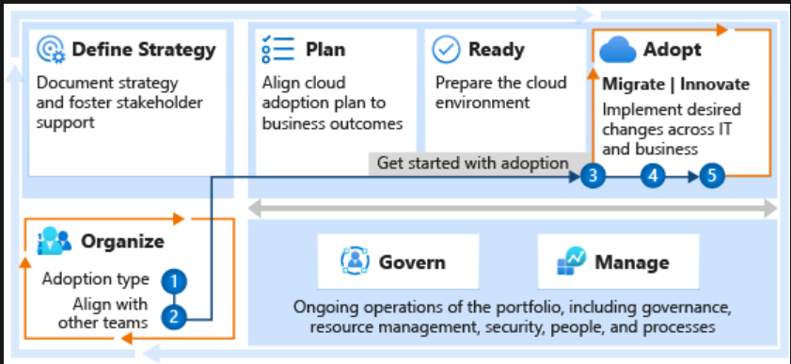
Align your organisation
Successful cloud adoption is the result of properly skilled people doing the appropriate types of work, in alignment with clearly defined business goals, and in a well-managed environment. To deliver an effective cloud operating model, it's important to establish appropriately staffed organisational structures. This article outlines such an approach.
Notes:
Structure type: Define the type of organizational structure that best fits your operating model. Cloud functions: Understand the cloud functionality required to adopt and operate the cloud. Mature team structures: Define the teams that can provide various cloud functions. RACI matrix: Clearly defined roles are an important aspect of any operating model. Use the provided RACI matrix to map responsibility, accountability, consulted, and informed roles to each of the teams for various functions of the cloud operating model.
Structure type
The following organizational structures do not necessarily have to map to an organizational chart (org chart). Org charts generally reflect command and control management structures. Conversely, the following organizational structures are designed to capture alignment of roles and responsibilities. In an agile, matrix organization, these structures may be best represented as virtual teams. There is no limitation suggesting that these organizational structures couldn't be represented in an org chart, but it is not necessary in order to produce an effective operating model.
The first step of managing organizational alignment is to determine how the following organizational structures will be fulfilled:
Org chart alignment: Management hierarchies, manager responsibilities, and staff alignment will align to organizational structures.
Virtual teams: Management structures and org charts remain unchanged. Instead, virtual teams will be created and tasked with the required functions.
Mixed model: More commonly, a mixture of org chart and virtual team alignment will be required to deliver on transformation goals.

Slide 24
Step 1: Understand the functions require for successful cloud teams
The following list outlines the minimum functionality that's required for your organisation to succeed at cloud adoption and long-term operations. After you become familiar with the cloud teams and their functions, you can align them with the organisational structure that best fits your staffing and cloud maturity level.
Cloud strategy: Align technical change to business needs.
Cloud adoption: Deliver technical solutions.
Cloud governance: Manage risk.
Central IT team: Support from existing IT staff.
Cloud operations: Support and operate adopted solutions.
Notes:
Cloud strategy functions – Roles are normally defined by the CIO
A cloud strategy team defines motivations and business outcomes and validates and maintains alignment between business priorities and cloud adoption efforts. In the absence of a defined cloud strategy team, someone must still provide the functionality that aligns technical activities to business outcomes. That same person or group should also manage change across the project.
Cloud adoption functions
Cloud adoption functions enable the implementation of technical solutions in the cloud. Like any IT project, the people delivering the actual work will determine success. The teams providing the necessary cloud adoption functions can be staffed from multiple subject matter experts or implementation partners.
Cloud adoption teams are the modern-day equivalent of technical implementation teams or project teams.
Minimum scope
The nucleus of all cloud adoption efforts is the cloud migration team. This team drives the technical changes that enable adoption. Depending on the objectives of the adoption effort, this team may include a diverse range of team members who handle a broad set of technical and business tasks.
At a minimum, the team scope includes:
Rationalization of the digital estate
Review, validation, and advancement of the prioritized migration backlog
The execution of the first workload as a learning opportunity.
Cloud governance functions
A cloud governance team ensure that risks and risk tolerance are properly evaluated and managed. This team ensures the proper identification of risks that can't be tolerated by the business. The people on this team convert risks into governing corporate policies.
Central IT team functions
As cloud adoption scales, cloud governance functions alone may not be sufficient to govern adoption efforts. When adoption is gradual, teams tend to organically develop the skills and processes needed to be ready for the cloud over time.
But when one cloud adoption team uses the cloud to achieve a high-profile business outcome, gradual adoption is seldom the case. Success follows success. This is also true for cloud adoption, but it happens at cloud scale. When cloud adoption expands from one team to multiple teams relatively quickly, additional support from existing IT staff is needed. But those staff members may lack the training and experience required to support the cloud using cloud-native IT tools. This often drives the formation of a central IT team governing the cloud.
Key responsibilities
Adapt existing IT practices to ensure adoption efforts result in well-governed, well-managed environments in the cloud.
Cloud operations functions
An operations team focuses on monitoring, repairing, and the remediation of issues related to traditional IT operations and assets. In the cloud, many of the capital costs and operations activities are transferred to the cloud provider, giving IT operations the opportunity to improve and provide significant additional value.

Slide 25
Step 1: Understand the functions require for successful cloud teams - continue
The following list outlines the minimum functionality that's required for your organisation to succeed at cloud adoption and long-term operations. After you become familiar with the cloud teams and their functions, you can align them with the organisational structure that best fits your staffing and cloud maturity level.
Cloud center of excellence: Improve quality, speed, and resiliency of adoption.
Cloud platform: Operate and mature the platform.
Cloud automation: Accelerate adoption and innovation.
Cloud data: Manage data and enable analytics solutions.
Cloud security: Manage information security risk.
Notes:
Cloud center of excellence (CCoE) functions
Business and technical agility are core objectives of most IT organizations. A cloud center of excellence (CCoE) is a function that creates a balance between speed and stability.
When successful, a CCoE model will create a significant cultural shift in IT. The fundamental premise of a CCoE approach is that IT serves as a broker, partner, or representative to the business. This model is a paradigm shift away from the traditional view of IT as an operations unit or abstraction layer between the business and IT assets.
Cloud platform functions
The cloud introduces many technical changes as well as opportunities to streamline technical solutions. But general IT principles and business needs stay the same. You still need to protect sensitive business data. If your IT platform depends on a local area network, there's a good chance that you'll need network definitions in the cloud. Users who need to access applications and data will want their current identities to access relevant cloud resources.
While the cloud presents the opportunity to learn new skills, your current architects should be able to directly apply their experiences and subject matter expertise. Cloud platform functions are usually provided by a select group of architects who focus on learning about the cloud platform. These architects then aid others in decision making and the proper application of controls to cloud environments.
Cloud automation functions
During cloud adoption efforts, cloud automation functions unlock the potential of DevOps and a cloud-native approach. Expertise in each of these areas can accelerate adoption and innovation.
The skills needed to provide cloud automation functions can be provided by:
DevOps engineers
Developers with DevOps and infrastructure expertise
IT engineers with DevOps and automation expertise
These subject matter experts might be providing functions in other areas such as cloud adoption, cloud governance, or cloud platform. After they demonstrate proficiency at automating complex workloads, you can recruit these experts to deliver automation value.
Cloud data functions
There are multiple audiences involved in an analytics conversation, including the typical seller, database architect, and infrastructure team. In addition, analytics solutions involve influencers, recommenders, and decision-makers from enterprise architecture, data science, business analysts, and executive leadership roles.
These teams are responsible for putting together complex solutions with components spanning integration across a wide swath of data tools and solutions. These include:
Structured and unstructured data
Transformation
Storage and retrieval
Analytic modeling
Message-based middleware
Data marts
Geo-redundancy and data consistency
Dashboarding and reporting
Security functions
Each of the following articles provide information about each function. Each article provides a summary of objectives, how the function can evolve because of the threat environment or cloud technology changes, and the relationships and dependencies that are critical to its success.
Policy and standards
Security operations
Security architecture
Security compliance management
People security
Application security and DevSecOps
Data security
Infrastructure and endpoint security
Identity and key management
Threat intelligence
Posture management
Incident preparation

Slide 26
Step 2: Map people to required functions
The next step is to map specific people to the necessary functions. To do so, answer the following questions:
What person or group will be responsible for completing technical tasks in the cloud adoption plan?
What person will be accountable for the team's ability to deliver technical changes?
What person or group will be responsible for implementing protective governance mechanisms?
What person will be accountable for defining those governance controls?
Are there other functions or people that will have accountability or responsibility within the cloud adoption plan?
After you've documented the answers to these questions, see Plans for skills readiness to help define your plans to prepare these people for forthcoming work.

Slide 27
Step 3: Determine how teams align within your organisation
The following organisational structures don't necessarily have to map to an organisational chart (org chart). Org charts generally reflect command and control management structures. Conversely, the following organizational structures are designed to capture alignment of roles and responsibilities.
In an agile matrix organization, these structures might be best represented as virtual teams. There's nothing to suggest that virtual teams couldn't be represented in an org chart, but a formal org chart isn't necessary to produce an effective operating model.
Determine how the following models fit your organizational structures:
Org Chart Alignment: Management hierarchies, manager responsibilities, and staff alignment will align with organizational structures.
Virtual-Teams (v-teams): Management structures and org charts remain unchanged. Instead, virtual teams will be created and tasked with the required functionality.
Mixed Model: More commonly, a mixture of org chart and virtual team alignment will be required to deliver on cloud transformation goals.

Slide 28
Step 4: Establish team structures
During every cloud adoption effort, certain functions must be provided by at least one person. These assignments and team structures can develop organically, or they can be intentionally designed to match a defined team structure.
To help create balance across cloud adoption efforts, we recommend that you start with a minimum of two teams.
The following two teams are responsible for various functions throughout the adoption effort:
Cloud Adoption Team: This team is accountable for technical solutions, business alignment, project management, and operations for the solutions that are adopted.
Cloud Governance Team: To balance the cloud adoption team, a cloud governance team is dedicated to ensuring excellence in the solutions that are adopted. The cloud governance team is accountable for platform maturity, platform operations, governance, and automation.
This proven approach is considered a minimum viable product (MVP), because it might not be sustainable. Each team wears many hats, as outlined in the RACI (responsible, accountable, consulted, and informed) charts.
As adoption needs grow, so does the need to create balance and structure. To meet those needs, companies often follow a process of maturing their organizational structures.
Watch this video to get an overview of common team structures at various stages of organizational maturity.

Slide 29
Step 5: Align RACI Charts
At each level of maturity, accountability for various cloud functions shifts to new teams. This shifting of accountability enables faster migration and innovation cycles by removing and automating barriers to change. To align assignments properly, the RACI alignment article shows a RACI chart for each organizational structure.
Additional information
Adapt existing roles, skills, and processes for the cloud
Organizational antipatterns: Silos and fiefdoms

Slide 30
Cloud adoption Team
The nucleus of all cloud adoption efforts is the cloud adoption team. This team drives the technical changes that enable adoption. Depending on the objectives of the adoption effort, this team might include a diverse range of team members who handle a broad set of technical and business tasks.
For small-scale or early-stage adoption efforts, this team might be as small as one person. In larger-scale or late-stage efforts, it's common to have several cloud adoption teams, each with around six engineers. Regardless of size or tasks, the consistent aspect of any cloud adoption team is that it provides the means to onboarding solutions into the cloud. For some organizations, this might be a sufficient organizational structure. The cloud adoption team article provides more insight into the structure, composition, and function of the cloud adoption team.
Best practice: Minimum viable product (MVP)
We recommend that you have two teams to create balance across cloud adoption efforts. These two teams are responsible for various functions throughout the adoption effort.
Cloud adoption team: This team is accountable for technical solutions, business alignment, project management, and operations for solutions that are adopted.
Cloud governance team: To balance the cloud adoption team, a cloud governance team is dedicated to ensuring excellence in the solutions that are adopted. The cloud governance team is accountable for platform maturity, platform operations, governance, and automation.
This proven approach is considered an MVP because it might not be sustainable. Each team is wearing many hats, as outlined in the responsible, accountable, consulted, informed (RACI) charts.
Notes:
Warning
Operating with only a cloud adoption team (or multiple cloud adoption teams) is considered an antipattern and should be avoided. At a minimum, consider the MVP best practice.

Slide 31
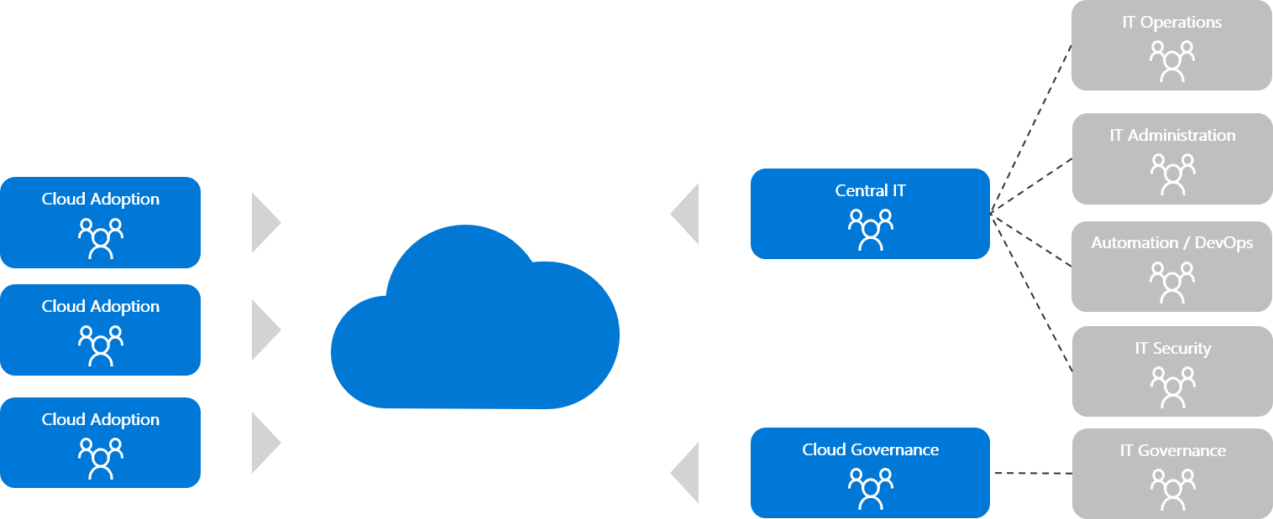
Central IT Team
The cloud doesn't require that everything change within the central IT team, but it does require significant change. If resistance to change is prevalent within the central IT team, this phase of maturity can quickly become a cultural antipattern.
Cloud adoption plans heavily focused on platform as a service (PaaS), DevOps, or other solutions that require less operations support are less likely to see value during this phase of maturity. On the contrary, these types of solutions are the most likely to be hindered or blocked by attempts to centralize IT. A higher level of maturity, like a cloud center of excellence (CCoE), is more likely to yield positive results for those types of transformational efforts.
Notes:
Warning
Operating with only a cloud adoption team (or multiple cloud adoption teams) is considered an antipattern and should be avoided. At a minimum, consider the MVP best practice.

Slide 32
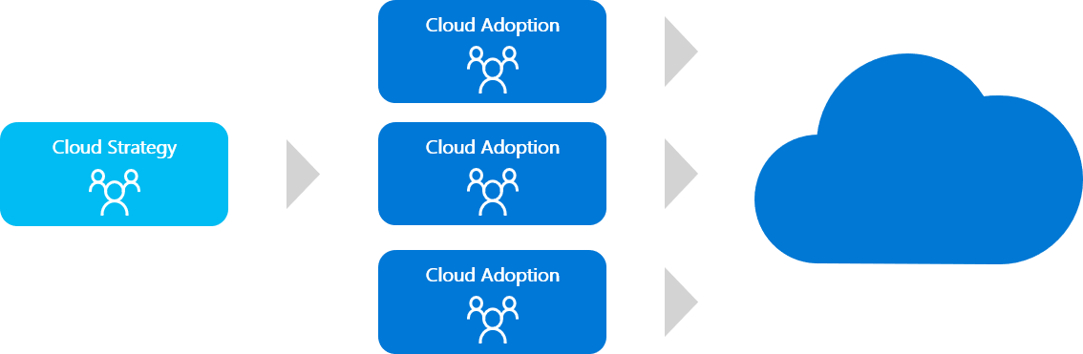
Strategic Alignment
As the investment in cloud adoption grows and business values are realized, business stakeholders often become more engaged. A defined cloud strategy team, as the following image illustrates, aligns those business stakeholders to maximize the value realized by cloud adoption investments.
When maturity happens organically, as a result of IT-led cloud adoption efforts, strategic alignment is usually preceded by a governance or central IT team. When cloud adoption efforts are lead by the business, the focus on operating model and organization tends to happen earlier. Whenever possible, business outcomes and the cloud strategy team should both be defined early in the process.
Notes:
Warning
Operating with only a cloud adoption team (or multiple cloud adoption teams) is considered an antipattern and should be avoided. At a minimum, consider the MVP best practice.

Slide 33
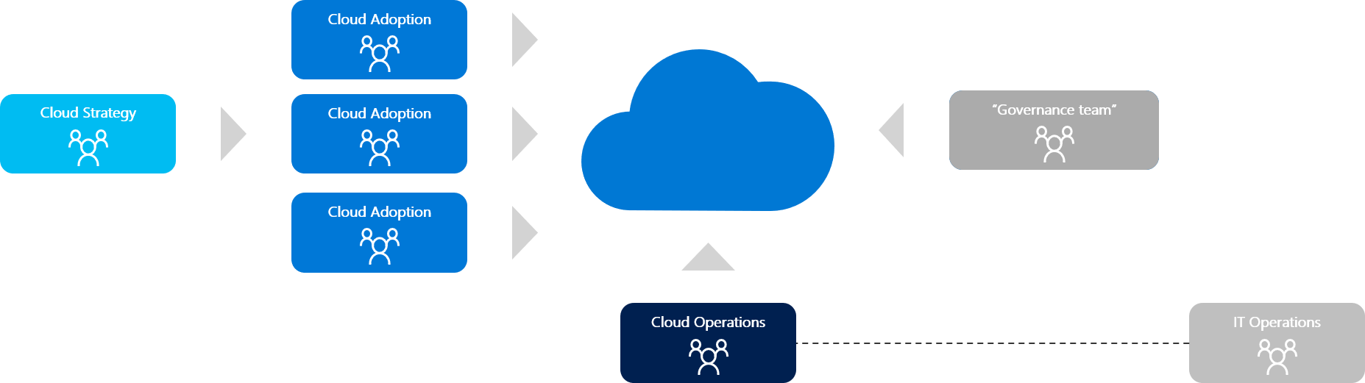
Operational Alignment
Realizing business value from cloud adoption efforts requires stable operations. Operations in the cloud might require new tools, processes, or skills. When stable IT operations are required to achieve business outcomes, it's important to add a defined cloud operations team, as shown here.
Cloud operations can be delivered by the existing IT operations roles. But it's not uncommon for cloud operations to be delegated to other parties outside of IT operations. Managed service providers, DevOps teams, and business unit IT often assume the responsibilities associated with cloud operations, with support and guardrails provided by IT operations. This is increasingly common for cloud adoption efforts that focus heavily on DevOps or PaaS deployments.
Notes:
Warning
Operating with only a cloud adoption team (or multiple cloud adoption teams) is considered an antipattern and should be avoided. At a minimum, consider the MVP best practice.

Slide 34
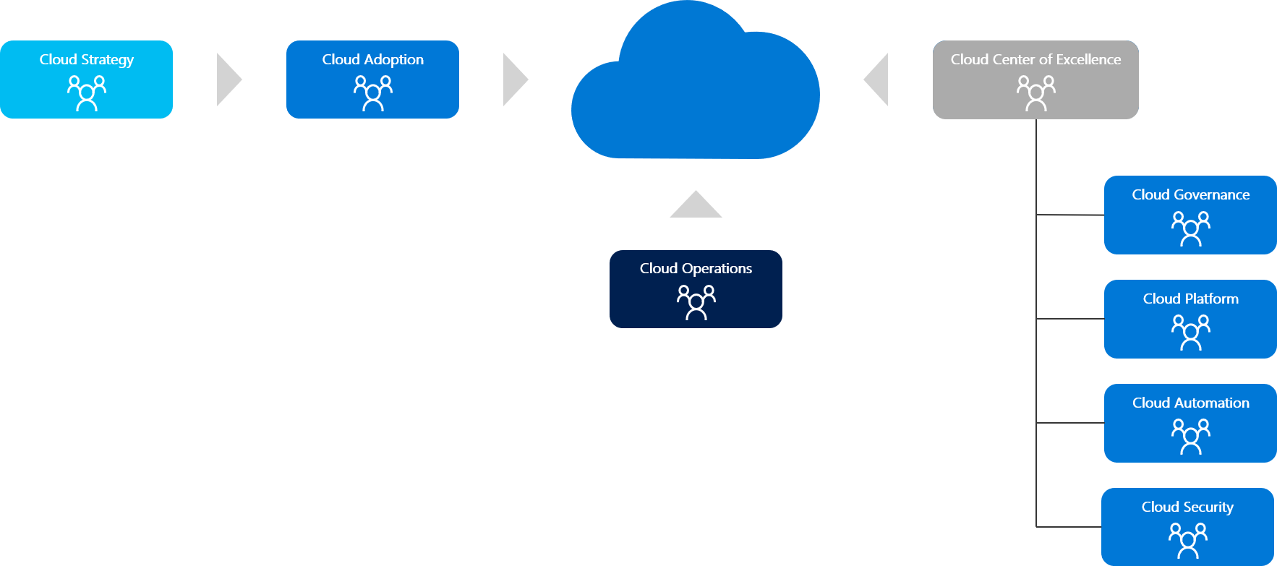
Cloud center of excellence
At the highest state of maturity, a cloud center of excellence aligns teams around a modern cloud-first operating model. This approach provides centralized IT functions like governance, security, platform, and automation.
The primary difference between this structure and the central IT team structure above is a strong focus on self-service and democratization. The teams in this structure organize with the intent of delegating control as much as possible. Aligning governance and compliance practices to cloud-native solutions creates guardrails and protection mechanisms. Unlike the central IT team model, the cloud-native approach maximizes innovation and minimizes operational overhead. For this model to be adopted, mutual agreement to modernize IT processes will be required from business and IT leadership. This model is unlikely to occur organically and often requires executive support.
Notes:
Warning
Operating with only a cloud adoption team (or multiple cloud adoption teams) is considered an antipattern and should be avoided. At a minimum, consider the MVP best practice.

Slide 35
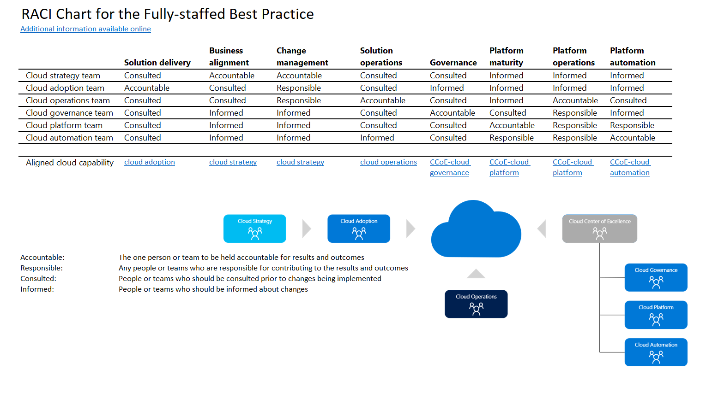

Slide 36
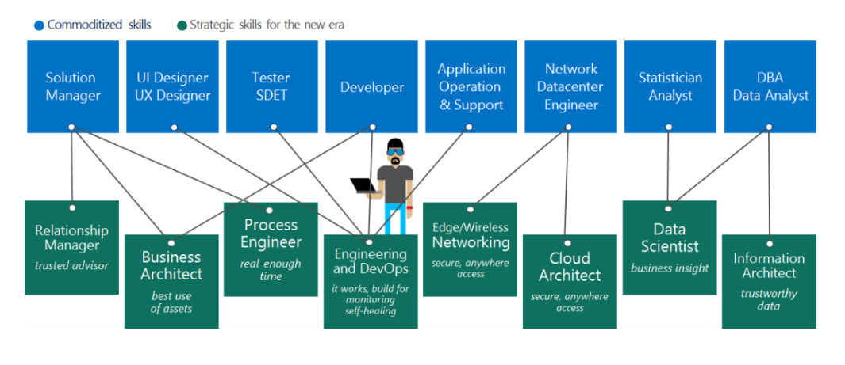
Build Skills Readiness Plan
Cloud computing is a technology shift, and a new set of skills are required to support cloud solutions
3
Create an org-wide learning plan
Identify the gaps
Look across teams
1
2
Notes:
Point of multiple role per person
Primary objective – IT roles are changing and the change has been significant over time. But the roles of IT professionals in the room are not all going to change tomorrow, there is a gradual evolution.
Delivery notes – Discuss how IT roles are evolving and based on your experience, how you have seen some old roles disappear (exchange, COBOL programmers, etc.) while new roles start being in demand (data scientists, Customer success managers, DevOps, Adoption, etc.). Discuss how scenarios will help design the small steps required to evolve the roles within the room.
From Microsoft internal experience when our IT moved to cloud we learned that beyond the need for changes to organizational culture, specific roles within IT must adapt to support the cloud model.
This was identified as one of the greatest benefits of cloud computing migration, but also the most disruptive.
Once migration to the cloud occurs, IT organizations are less involved in the day-to-day operations of running servers, and are free to expand their roles to include more solution-focused responsibilities.
This provides additional opportunities for growth in the careers of IT professionals, as they move from technology and service providers to business process enablers.
The majority of role changes that cloud computing enables in the IT environment involve the reduced focus on infrastructure. Once the majority of infrastructure maintenance tasks are absorbed into the cloud infrastructure, the time and capital historically spent on infrastructure will be freed up for more creative and innovative areas of IT management.

Slide 37
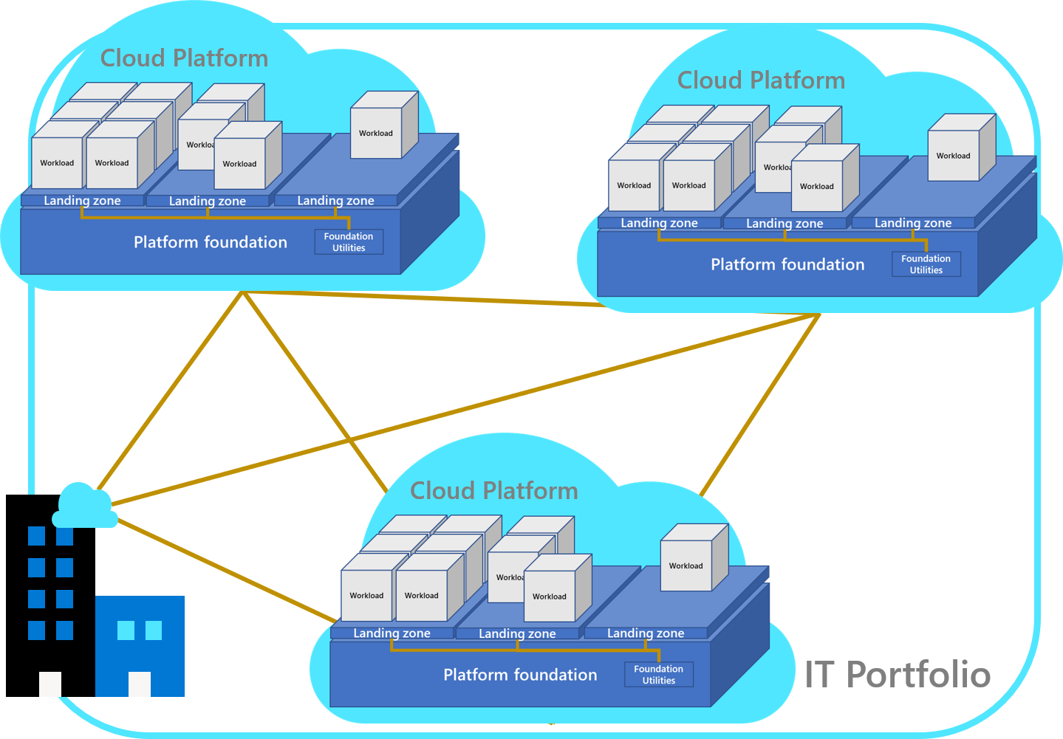
Understand and align the portfolio hierarchy - Cloud Adoption Framework | Microsoft Docs
Understand and align the portfolio hierarchy
Asset: The smallest unit of technical function that supports a workload or solution.
Workload: The smallest unit of IT support for the business. A workload is a collection of assets (infrastructure, applications, and data) that supports a common business goal or the execution of a common business process.
Notes:
Landing zones: Landing zones provide workloads with the necessary foundational utilities (or shared plumbing) that are provided from a platform foundation that's required to support one or more workloads. Landing zones are so critical in the cloud that the entire Ready methodology of the Cloud Adoption Framework focuses on landing zones. For a more detailed definition, see What is a landing zone?
Foundational utilities: These shared IT services are required for workloads to operate within the technology and business portfolio.
Platform foundation: This organizational construct centralizes foundational solutions and helps ensure that those controls are enforced for all landing zones.
Cloud platforms: Depending on the overall strategy for supporting the full portfolio, customers might need multiple cloud platforms with distinct deployments of the platform foundation to govern multiple regions, hybrid solutions, or even multicloud solutions.
Portfolio: Through a technology lens, the portfolio is a collection of workloads, assets, and supporting resources that span all cloud platforms. Through a business lens, the portfolio is the collection of projects, people, processes, and investments that support and manage the technology portfolio to drive business outcomes. Together, these two lenses capture the portfolio.

Slide 38
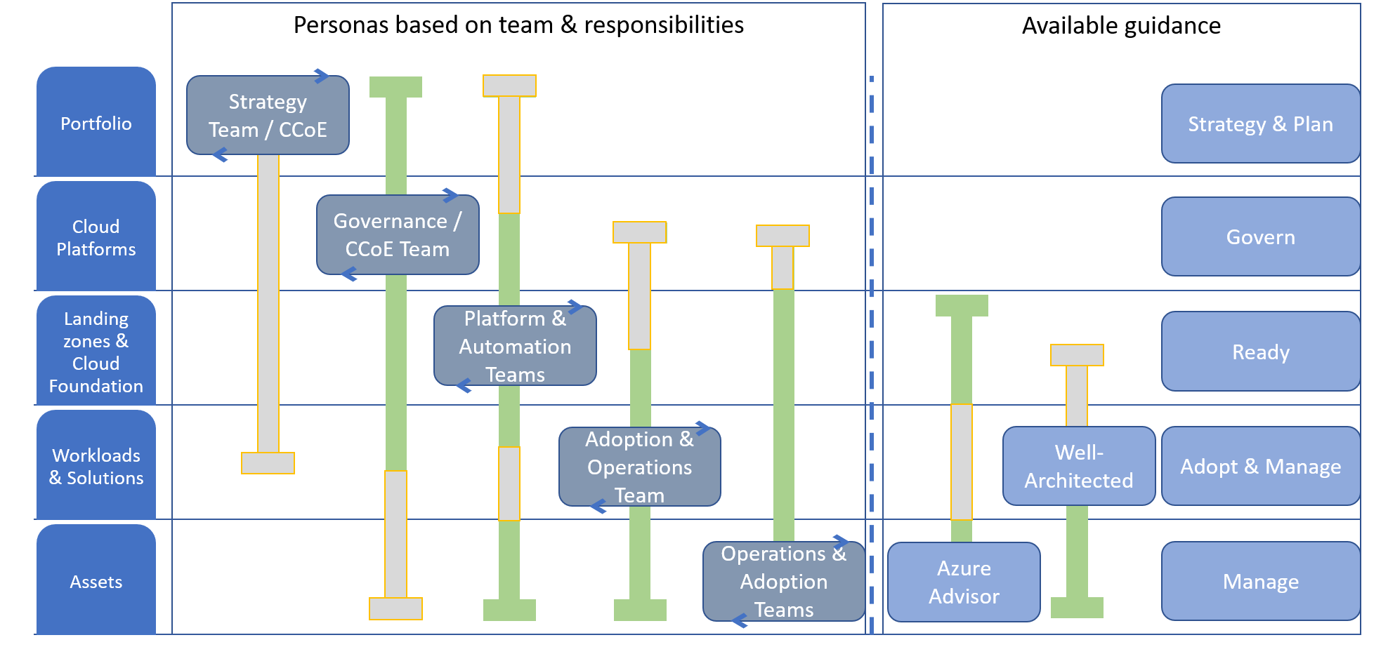
Hierarchy accountability and guidance
Notes:
Portfolio: The cloud strategy team and the cloud center of excellence (CCoE) use the Strategy and Plan methodologies to guide decisions that affect the overall portfolio. The cloud strategy team is accountable for the enterprise level of the cloud portfolio hierarchy. The cloud strategy team should also be informed of decisions about the environment, landing zones, and high-priority workloads.
Cloud platforms: The cloud governance team is accountable for the disciplines that ensure consistency across each environment in alignment with the Govern methodology. The cloud governance team is accountable for governance of all resources in all environments. The cloud governance team should be consulted on changes that might require an exception or change to governing policies. The cloud governance team should also be informed of progress with workload and asset adoption.
Landing zones and cloud foundation: The cloud platform team is accountable for developing the landing zones and platform utilities that support adoption. The cloud automation team is accountable for automating the development of, and ongoing support for, those landing zones and platform utilities. Both teams use the Ready methodology to guide implementation. Both teams should be informed of progress with workload adoption and any changes to the enterprise or environment.
Workloads: Adoption happens at the workload level. Cloud adoption teams use the Migrate and Innovate methodologies to establish scalable processes to accelerate adoption. After adoption is complete, the ownership of workloads is likely transferred to a cloud operations team that uses the Manage methodology to guide operations management. Both teams should be comfortable using the Microsoft Azure Well-Architected Framework to make detailed architectural decisions that affect the workloads they support. Both teams should be informed of changes to landing zones and environments. Both teams might occasionally contribute to landing zone features.
Assets: Assets are typically the responsibility of the cloud operations team. That team uses the management baseline in the Manage methodology to guide operations management decisions. It should also use Azure Advisor and the Azure Well-Architected Framework to make detailed resource and architectural changes that are required to deliver on operations requirements.

Slide 39
Skilling

Slide 40
title
Aligned learning experiences in a digital-first world
Self-paced learning
Training events
Instructor led training
Certifications
Build practical job skills with easily accessible, free, self-paced courses
Choose from workshops, conferences, and other training events
Attend virtual or in-person training taught by Microsoft Certified Trainers
Validate skills with fundamentals, role-based, and specialty certifications
Online learning paths
Microsoft training events
Microsoft Official Courses
Microsoft Certification
Notes:
Microsoft offers many training options so technical professionals can choose to learn in a style that fits them best. These learning experiences help them to be ready for the job and to prepare for certifications. ​
​
Our collection of learning experiences supports the complete learning journey. These experiences can be combined for optimal results​.
Use self-paced learning to build practical job skills with easily accessible, free learning paths.
Attend training events to get a unique upskilling experience. We offer traditional presentation-based conferences, demonstrations, discussions, and practical, applicable workshops, plus hands-on coding experiences.​ As with Microsoft Build and Microsoft Ignite, you can now attend these events online.
Attend in-depth instructor-led training, either virtually or in-person, using Microsoft Official Courseware, also known as MOC, taught by Microsoft Certified Trainers​, sometimes referred to as MCTs, and delivered by Microsoft Learning Partners.
Use any and all of these training options to build your foundation for skills validation and recognition with Microsoft Certification. ​

Slide 41
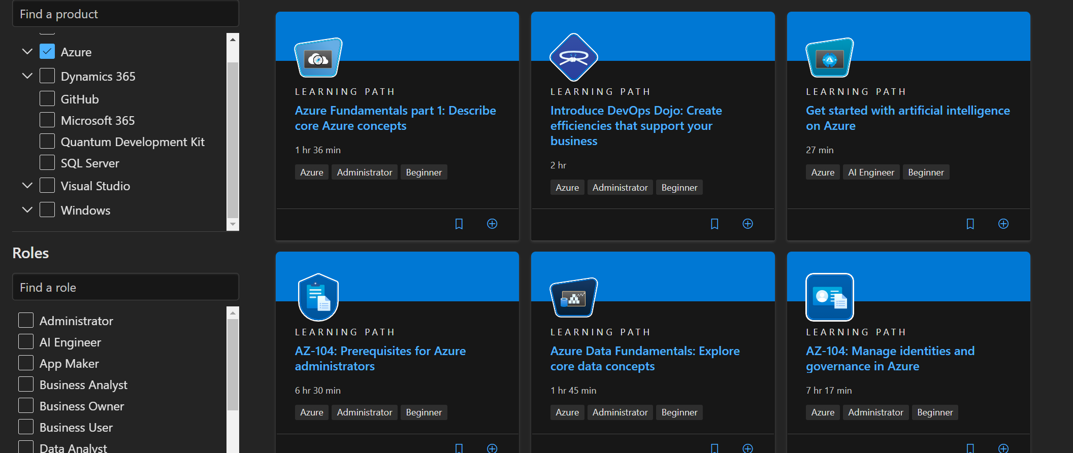
MSLearn - Azure on Microsoft Learn | Microsoft Docs

Slide 42
Azure Service Health and Incident management

Slide 43




Azure Service Health
aka.ms/AzureServiceHealth
Access a personalized dashboard
Find timely information about service issues, planned maintenance, and health advisories for your resources right from the Azure portal, and pin a filtered view that helps you focus on what’s important.
Set up targeted notifications
Azure Service Health integrates into Azure Monitor to alert you and your teams via emails, text messages, and webhook notifications when your business-critical resources are impacted.
Receive guidance and support
When an Azure issue impacts your resources, Service Health helps you diagnose and get support. You’ll receive updates on how Azure is fixing the issue until everything is resolved.
Share details and updates easily
Get a link for the issue to use in your problem-management system and download a PDF summary of the issue to share with people who don’t have access to the Azure portal.
More information: aka.ms/ash-docs
Notes:
Unlike our public page (status.azure.com) which provides general status information, Azure Service Health (in the Azure portal) provides tailored information for your resources.
Azure Service Health is a personalized dashboard that provides guidance and support when issues in Azure services affect you. It also helps you prepare for planned maintenance and other changes that could affect the availability of your resources. With Azure Service Health, you can easily configure alerts to ensure that your relevant teams are notified of service health events affecting their resources.
From your personalized dashboard in Azure Service Health, you can view:
Service issues – ongoing issues in Azure services that are impacting your resources. Quickly understand when the issue began and what services, regions, and specific resources are impacted. Share a link referencing the issue with your team or download a PDF summary to share with people who don’t have access to the Azure portal.
Planned maintenance – upcoming maintenance activities in Azure that will affect your resources. Understand when the maintenance will begin. And in the case of virtual machines maintenance, Service Health also shows the exact list of your VMs that will be affected and gives you the ability to perform maintenance on your schedule.
Health advisories – summaries of recommended actions to prevent downtime, including when older Azure features are being retired or if you exceed a usage quota.
Health history – past service issues that have affected the health of your resources, including post-incident summaries after issues have been resolved. Resource health – resource-level health insights for your resources. Look up a specific resource (like a VM) to see any current or historical health issues.

Slide 44
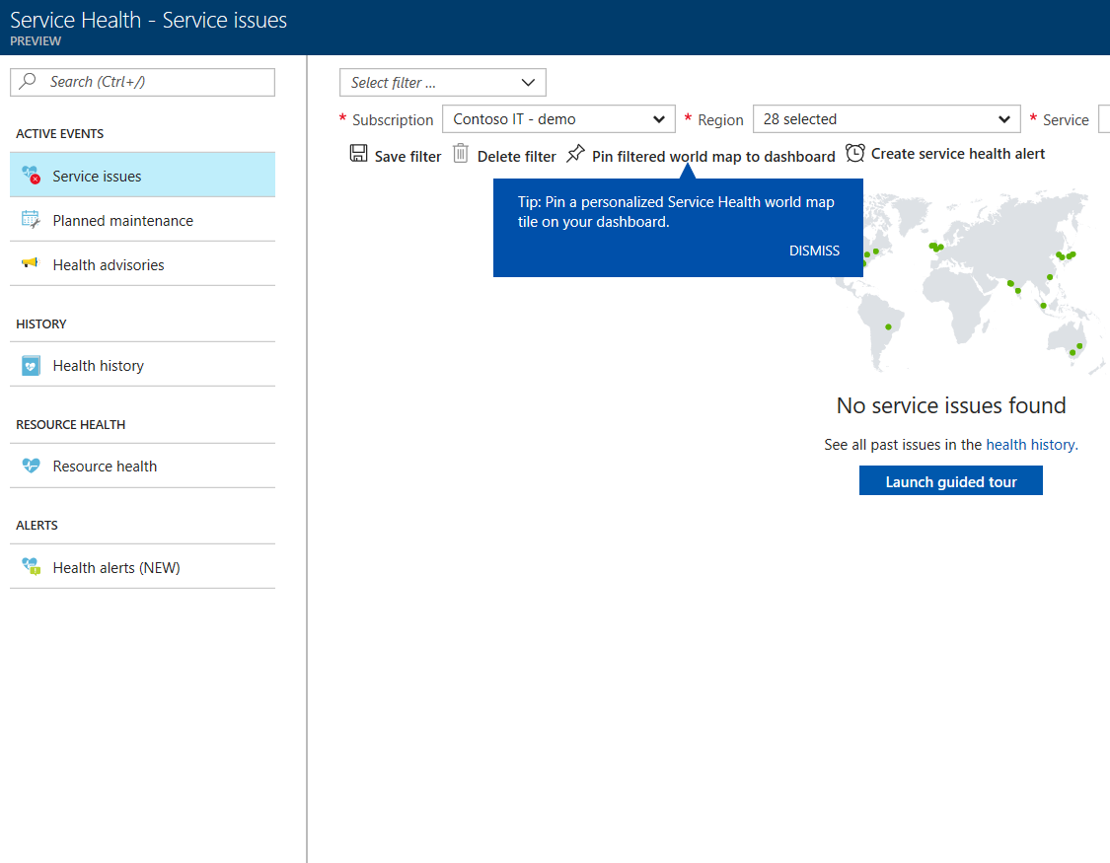
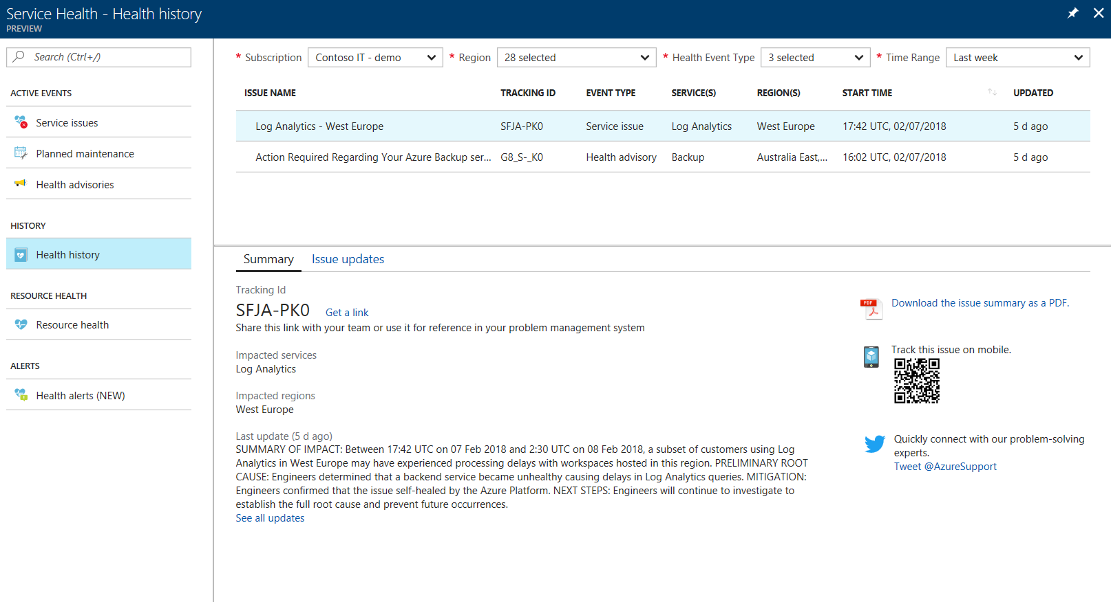
Azure communicates incidents, upcoming maintenance, and health advisories via Azure Service Health
Azure Service Health alerts are strongly recommended for production systems
Examples of alerts include:
An alert to email your dev team when a resource in a test/dev subscription is impacted.
An alert to update ServiceNow via webhook when a resource in production is impacted.
An alert to send an SMS to a specific number when resources in a given region are impacted.
status.azure.com is only used to communicate issues with widespread impact.
Notes:
All customers and partners using Azure should configure Service Health alerts to receive automatic notifications of any issues/maintenance/etc. through your preferred channels – e.g. email, SMS, webhook, etc.
Service Health alerts are completely configurable, to ensure that the right people in your organization are notified appropriately. For example:
An alert to email your dev team when a resource in a test/dev subscription is impacted
An alert to update ServiceNow via webhook when a resource in a production subscription is impacted
An alert to send an SMS to a specific number when resources in a given region are impacted
Customize your alerts by triggering them based on:
Notification type(s): issue/maintenance/advisory
The subscription affected
The service(s) affected
The region(s) affected
In the unlikely event of a service issue impacting your ability to access Azure Service Health or the Azure portal itself, status.azure.com is used to communicate updates.
https://azure.microsoft.com/en-us/features/service-health/

Slide 45
Preparing for the unexpected: How to mitigate impact of issues & stay informed
What exactly is a “service incident”? Service incident is the term that Microsoft uses to refer to an event (or series of events) that typically causes multiple customers to have a degraded experience with one or more of our services. These incidents are effectively platform issues that cause unplanned downtime – including unavailability, performance degradation, and problems interfering with service management. When an Azure incident is declared, we send updates to all impacted subscriptions to provide visibility and relevant guidance. | Why should I use Service Health instead of status.azure.com? Many customers check status.azure.com at the first signs of potential issues, to see if there are known issues on the Azure platform at the time. This page shows widespread issues, but doesn’t show smaller incidents that impact fewer customers. Azure Service Health (within the Azure portal) knows which subscriptions you manage, so it shows a much more accurate view of any known issues impacting your resources. It also lets you configure health alerts, to find out about any issues through your preferred communication channel(s) – email, SMS, webhook, etc. | When do I need to open a Microsoft support case? During an active incident, many customers and partners contact support (or their account teams) asking for information – but all of the details about an active incident, including the latest updates, are available in Service Health and through its health alerts. Customers can and should contact Microsoft support to troubleshoot issues that don’t match the impact described in Service Health, but don’t need to contact support just for updates. This way, support engineers are available to assist customers with failover activities, or to help with any unrelated but urgent issues.
Before an incident
Understand resilience and ensure that all of your critical services are architected for high availability.
Get familiar with Azure Service Health in the Azure portal – your ‘go to’ place in case of issues.
Configure Service Health alerts to notify you about any issues – by email, SMS, webhook, etc.
Consider Resource Health alerts or Scheduled Events to inform you of resource-specific issues.
During an incident
Review Azure Service Health within the Azure portal for the latest updates from our engineers.
If there are issues accessing Service Health or the portal itself, check the public Azure Status page.
If there are ever issues with the Status page, check for any updates via @AzureSupport on Twitter.
If your impact/issues don’t match the incident (or if these persist after mitigation) contact support.
Notes:
SOME CONTEXT…
When we talk about an “incident” or “service issue” here, we’re specifically talking about an issue on ‘our’ Azure/Microsoft side – a platform side issue that is impacting customer services. During these rare but inevitable issues, our goal is to be as transparent as possible with impacted customers by providing regular updates direct from our engineers. We endeavor to inform the right people through the right channels (more on that below) and to share as much detail as possible. Although we generally don’t share speculation or the inner workings of troubleshooting steps, we share everything that we know about the incident with customers. There is no delay in messaging (or more detailed messaging) based on customer size/segment, partner status, or support plan – so Microsoft partner organizations and even Microsoft account teams are notified at the same time and with the same updates as the impacted customers they represent.
BEFORE AN INCIDENT…
1. Understand resilience and ensure that all of your critical services are architected for high availability.
the key is to ‘choose your battles’ when it comes to high availability. Decide as an organization which applications/workloads are mission-critical, then invest time to removing single points of failure. https://docs.microsoft.com/en-us/azure/architecture/reliability/ provides an even more detailed overview of resilient architectures. There are many important considerations listed, but The topics covered include defining requirements, architectural best practices, consistent deployment monitoring application health, responding to failures.
2. Get familiar with Azure Service Health in the Azure portal – your ‘go to’ place in case of issues.
Unlike our public status.azure.com page which provides general status information, Azure Service Health provides tailored information for your resources. It also helps you prepare for planned maintenance and other changes that could affect the availability of your resources. Service Health can provide alerts and guidance when outages, maintenance or any service issues are affecting you. It can notify you, help you understand the impact of issues, and keep you updated as the issue resolves. From Service Health you can build a personalized dashboard to show the status of whichever resources your care about. If a service issue ever does impact your resources, you can download a PDF summary of the issue (complete with the latest updates from Microsoft engineers) for sharing with stakeholders who don’t have portal access. Finally, from within Service Health you can request Root Cause Analyses (RCAs) for any issues that have impacted you.
3. Configure Service Health alerts to notify you about any issues – by email, SMS, webhook, etc.
Setting up service health alert notifications is the most important call to action here. This is to inform customers of all service impacting events that we communicate. It includes, outages, maintenance or if we have something to tell you that could impact your workloads. Customers want to be notified when there are issues impacting their services, and service health alerts gives them the power to choose HOW and TO WHOM these alerts are sent. Customers can setup alerts to trigger emails, SMS messages, logic apps, functions and more – for Enterprise customers who are already using a problem management system, the webhook option means customers can wire service health alerts into ServiceNow, PagerDuty, etc. Remember that the vast majority of service issues impact only a very small number of customers, so these won’t show up on places like status.azure.com. Service health alerts can be configured from the portal – for customers looking to automate creation, they can also be configured via PowerShell or ARM templates.
4. Consider Resource Health alerts or Scheduled Events to inform you of resource-specific issues.
Once customers have setup service health alerts, they should consider also adopting resource health alerts. The most important thing to understand about the difference between ‘service health’ alerts and ‘resource health’ alerts is that the former only fires during a known platform issue, like an outage that’s being investigated. By contrast, the latter fires when a specific resource is unhealthy, regardless of the reason why. Sometimes a resource like a VM may have issues that are not related to platform issues. The link for setting up resource health alerts is https://docs.microsoft.com/en-us/azure/service-health/resource-health-alert-arm-template-guide - since this is a more specialized task, resource health alerts can only be configured using ARM templates, there is no UI available in the portal. This helps to protect customers with a large number of resources from spamming themselves.
Scheduled events is another great tool – where both of the ‘alerts’ above notify people, scheduled events notify the resources themselves. This can give your application time to prepare for VM maintenance or one of our automated service healing events. It provides a signal about an imminent maintenance event (for example, an upcoming reboot) so that your application can know that and then act to limit disruption – for example, by running automation to drop itself out of the pool or otherwise degrade gracefully. Scheduled events are available for all Azure Virtual Machine types including PaaS and IaaS on both Windows and Linux.
Although both resource health alerts and scheduled events are helpful tools for these scenarios outlined, the most important call to action is for customers to configure service health alerts covering all of the subscriptions/services for which they would like to understand when a known platform issue is causing them impact. This is absolutely critical to ensure that customers understand what’s happening, what Microsoft is doing about it, and when issues are mitigated.
DURING AN INCIDENT…
1. Review Azure Service Health within the Azure portal for the latest updates from our engineers.
If a customer notices an issue and wants to understand ‘is it us or is it Azure’ then checking Azure Service Health in the portal should be the first port of call. Although customers should be aware of this ‘go to’ place, they shouldn’t need to hunt for information reactively, if they have configured the relevant service health alerts beforehand. During a known issue, these service health alert(s) will trigger, and they will be notified using their chosen communications channel.
2. If there are issues accessing Service Health or the portal itself, check the public Azure Status page.
In the unlikely event that a service issue gets in the way of customers being able to access Service Health, the Azure portal, being able to log in, etc. then the Azure Status page (status.azure.com) is used to post issue updates. This page is only used for issues like this that disrupt the usual communications path, or for rare widespread issues – for example, impacting multiple services/regions. It’s important to remind customers that this really serves as a backup – since most issues only impact a small number of subscriptions, most issue notifications are sent only to the specific impacted subscriptions, via Service Health.
3. If there are ever issues with the Status page, check for any updates via @AzureSupport on Twitter.
Only a few times in the history of Azure, there have been technical issues preventing posting incident updates on status.azure.com – in these extraordinary circumstances, we post incident updates via Twitter from @AzureSupport. But regardless of the issue, customers should feel free to reach out to @AzureSupport for any questions relating to potential issues they’re seeing or with support questions. The @AzureSupport team generally responds in less than 5 minutes (we’re very proud of that!) but it’s important to know that during known issues (for example, if there’s an outage listed in Service Health) then the incident is already being worked on by the right engineers so there is potentially not much that the @AzureSupport team will be able to do to help, beyond directing customers to the official engineering updates of what’s happening.
4. If your impact/issues don’t match the incident (or if these persist after mitigation) contact support.
This is the most important note for customers to understand about what to do (or not to do) during an incident. As mentioned above ,during known issues (for example, if there’s an outage listed in Service Health) then the incident is already being worked on by the right engineers – so customers don’t need to contact support for updates. They will receive regular updates via Service Health (and their Service health alerts) and support engineers don’t have access to any more detailed information than what is provided to impacted customers. If customers have read the updates from engineering but require support to respond to the incident (for example, to implement their failover plans) then they can and should raise a support ticket. Similarly, if the symptoms they are noticing doesn’t seem to ‘line up’ with the symptoms being described in the issue updates (for example, if there is a known issue with Redis Cache in US East, but they’re seeing issues with a Redis Cache in US East 2) then it may be unrelated and customers can and should raise a support ticket. Finally, if a service issue is resolved/mitigated but the customer is still seeing issues with their services, then support engineers can help them to see if there is something special going on with their resources, so customers can and should raise a support ticket.
AFTER AN INCIDENT…
Azure status history | Microsoft Azure
We haven’t listed ‘after issue’ steps here since things are relatively straight-forward. The final issue update will summarize what happened, and this is provided through the same communication channels (in Service Health, and via Service Health alerts). For widespread issues, a detailed Root Cause Analysis (RCA) will be provided within five days of mitigation. This is posted to all impacted subscriptions within Service Health. For issues that were published on status.azure.com, the RCA will also be posted there. For smaller issues that don’t have a detailed RCA provided, customers will see the option within Service Health to request an RCA if additional details are required. Finally, if customers believe that a service issue meant that Azure did not meet any of its Service Level Agreements (SLAs), they can raise a billing support ticket (from the Azure portal) listing the incident tracking ID (from Service Health), so that our billing teams can calculate any relevant SLA credits.

Slide 46
Understanding SLA’s and resilience requirements

Slide 47
Building systems that survive failure is a shared responsibility
Your application
Your app or workload architecture, built on the below.
Resilient services
Azure capabilities you enable as needed – for high availability, disaster recovery, and backup.
Resilient foundation
Azure capabilities built into the platform – how the foundation is designed, operated, and monitored to ensure availability.

Slide 48

Complex systems need resilience to deliver reliability
Reliability
Reliability is the ‘what’. It is the goal for production systems, to ensure availability of their services. You want to maintain reliable systems, with the appropriate level of availability/uptime.
Resilience
Resilience is the ‘how’. It is the way in which production systems can achieve reliability. The objective is not to avoid any and all failures – it is to respond to failure in a way that avoids downtime and data loss.
Notes:
Just like avoiding change is impossible in the public cloud, avoiding failure is not a reasonable goal – we all need to plan to respond to failure gracefully.

Slide 49
Resiliency in the public cloud
Resiliency is a joint effort between customers and service providers
Customer’s responsibility
IaaS
PaaS
SaaS
Resiliency considerations
Database / data
High availability, DR, backup
Workload / application
High availability, DR, backup
Virtual Machine / OS
High availability, DR, backup
Storage
High availability, DR, backup
Networking
High availability, DR
Power / facility
High availability, DR
Service provider’s responsibility
Notes:
Building a reliable application in the cloud is different than building a reliable application in an enterprise setting. While historically you may have purchased higher-end hardware to scale up, in a cloud environment you must scale out instead of scaling up. Costs for cloud environments are kept low through the use of commodity hardware. Instead of focusing on preventing failures and optimizing "mean time between failures," in this new environment the focus shifts to "mean time to restore." The goal is to minimize the effect of a failure.
It’s also a joint responsibility between the service provider and the customer. It’s a joint responsibility to build a resilient application especially in an IaaS model. Customers have the responsibility to keep their virtual machines, applications and workloads, and data resilient.

Slide 50
Service levels – your contracts, measurements, goals
Understanding your own uptime requirements informs your priorities for monitoring & resilience
Service Level Agreements (SLAs)
Any external facing agreements – between Microsoft and you, and/or between you and your end customers.
Microsoft guarantees 99.9% uptime for these virtual machines, but you may offer different end-user guarantees.
Service Level Objectives (SLOs)
Your internal organisational or team goals, based on the business requirements of each application and its users.
e.g. App is considered ‘successful’ if X% of user requests are processed within Y seconds, over a trailing Z time period.
Could include raw availability, but also perhaps latency/throughput/coverage/correctness/quality/freshness/durability.
Service Level Indicators (SLIs)
Internally measured but could potentially be shared externally – e.g. here’s how well this app is currently performing.
Usually a ratio/proportion & a ‘how’ e.g. # of successful HTTP calls / # of HTTP calls, as measured at the load balancer.
Importance of defining these for your organization
Ensures alignment between business and IT stakeholders, to set expectations and prioritize various apps/workloads.
Objectives inform architectural requirements for high availability vs disaster recovery vs backup/restore capabilities.
Notes:
Don’t “rely” on the Azure SLA as the be-all-and-end-all of availability metrics – uptime means different things for different apps/orgs, define (and measure!) your own to understand what’s important.
There are very few cases where 100% reliable is a good goal. The idea behind this, there is an ‘appropriate’ level of reliability. If you shoot for 100% reliability (good thing to shoot for, if you’re a medical device manufacturer, or if you’re keeping planes in the sky) but in almost all other cases 100% is the wrong number to shoot for.
Firstly, it’s expensive – the more reliable you try to get, the more expensive it gets.
Secondly, it leaves no room for growth – when you’re 100% reliable, the only thing you can do is react to unreliability.
Thirdly, it’s unrealistic – chances are your dependencies aren’t 100% reliable, the intermediate path (e.g. cable provider) isn’t always reliable, so you’re burning money being available when your user can’t get to you, etc.
https://www.youtube.com/watch?v=1iMo3SkdQqQ&t=770s

Slide 51
Application availability needs
Examples of applications commonly seen at each availability tier
99.999%
ATM transactions, telecommunications systems
99.99%
Video delivery, broadcast systems
Availability
99.95%
Online commerce, point of sale
99.9%
Internal tools like knowledge management, project tracking
99%
Batch processing, data extraction, transfer, and load jobs
Cost + complexity
Notes:
There are levels of application resilience goals based on possible length of interruptions.
Service availability is commonly defined as the percentage of time that an application is operating normally. That is, it’s the percentage of time that it’s correctly performing the operations expected of it. This percentage is calculated over periods of time, such as a month, year, or trailing 3 years. Applying the strictest possible interpretation, availability is reduced any time the application isn’t operating normally, including both scheduled and unscheduled interruptions. We define availability using the following criteria:
Availability = Normal Operation Time / Total Time
A percentage of uptime (such as 99.9%) over a period of time (commonly a year)
Common short-hand refers only to the “number of 9’s”; for example, “five nines” translates to 99.999% available
Some customers choose to exclude scheduled service downtime (for example, planned maintenance) from the Total Time in the formula in the first bullet. However, this is often a false choice because customers might actually want to use your service during these times.
Here is a table of common application availability design goals and the possible length of interruptions that can occur within a year while still meeting the goal. The table contains examples of the types of applications we commonly see at each availability tier.

Slide 52

Types of failures you need Resilience from
Improved availability
Build and run highly-available applications with near-zero RPO/RTO
Implement disaster recovery plan with data residency and minimal RPO/RTO
Customer
need
Premium Storage
Availability Sets
Availability Zones
Azure Site Recovery
Region 1
Region 2
Region 1
Zone 1
Data center 1
Single VM
Data center 1
Zone 1
Zone 1
Data center 1
Zone1
Data center 2
Zone 2
Zone 3
Zone 2
Zone 2
Zone 3
Zone 3
Host Infrastructure
SLA 99.9%
SLA 99.95%
SLA 99.99%
RTO 30 minutes
Blast radius
Hardware failure
Rack level failure
Datacenter outage
Natural Disaster
Scope of Impact
Accidental data loss
Data corruption
Ransomware
Data
Go back to point-in-time to restore the healthier version of data
Backup
Notes:
So we have seen how Resilience is not about avoiding any failure but bouncing back from one. Let’s look at some typical failures that may lead to a downtime for your application –
This trapezium shows the degree of impact that a failure can potentially cause. So while, a power or a network outage may impact a datacenter of a multiple data centers in a zone; something more catastrophic like a flood or earthquake can take down the entire region. All these failures primarily impact your infrastructure (which comprises of both applications and the data).
There’s one thing that is common across though, no matter what your deployment is (you can be running the entire set up in a single region vs spread across zones), you will most likely have data; data which is stateful; data which you would need to go back to.
The failures impacting this data look like these. And to draw a parallel, these too in some sense have varying degree of impact of these failures on the data; while accidental deletion may lead to losing a file or folder; a rogue admin can wipe off not only your data but also your backups.
Thus, we need to build resilience against all these failure and the azure services can help us achieve just that.
Opt for Premium storage that allows for 99.5% availability in case of a single VM deployment.
Up your Resilience game with High Availability structures; deploy your architecture in Availability sets or AZs to get SLA up to 99.99%. HA should be preferred for your mission critical apps which have very stringent RPO and RTO requirements (almost real time).
Go one step head to further isolate your VMs by making used of paired regions in azure. The recently previewed feature for storage account failover when configured for GRS also is a subset of this solution.
But none of them still covers you for data failures; and that’s because all of these deployments are almost constantly syncing data across; so if any data corruption happens and I need to go back in time to say a couple of days, I need to have backed-up that version. Hence, we have Backup.

Slide 53
Azure Updates

Slide 54
How do I stay current in an ever-changing world
Azure Service Health: Service Health alerts provide timely notifications about ongoing service issues, planned maintenance, and health advisories. These alerts also includes information about Azure features scheduled for retirement.
Azure updates: Review Azure updates for announcements about product updates. Brief summaries link to additional details, making the updates easy to follow. Subscribe via the Azure updates RSS feed.
Azure blog: The Azure blog communicates the most important announcements for the Azure platform. Follow this blog to stay up to date on critical information. Subscribe via the Azure blog RSS feed.
Service-specific blogs: Many individual Azure services publish blogs that you can follow if you rely on those services. Find the ones you're interested in via a web search.
Azure Info Hub: The unofficial Azure Info Hub pulls together most of the resources listed here. Follow links to individual services to get detailed information and find service-specific blogs. Subscribe via the Azure Info Hub RSS feed. *

Slide 55
Community resources
Azure Friday: Weekly videos with the engineers who build Azure. They do demos, answer questions, and share insights. Subscribe via the Azure Friday RSS feed.
Azure Charts: This visualization shows all the Azure updates made in the last six months. It contains other useful charts and utilities to help you track Azure changes. *
AzAdvertizer: Release and change tracking on Azure governance capabilities such as Azure Policy, policy initiatives, policy aliases and Azure role-based access control (Azure RBAC). *
Azure Weekly*
This newsletter provided by endjin.com includes a summary of the week's top news about Microsoft Azure. It also includes interesting historical content. Subscribe via the Azure Weekly email. *
* These resources are provided by the community and are not officially maintained by Microsoft.

Slide 56
Next steps
Don’t Panic
Cloud Adoption
Not just technology it is about culture change, innovation and so much more. The Cloud Adoption Framework provide great guidance on aligning business, people and technology strategies to achieve business goals with actionable, efficient, and comprehensive guidance to deliver fast results with control and stability
Determine the Operating model best suited for your business
Roles
Skilling
Review current Service Management processes to understand how they need to adapt to make use of
Azure Service Health – Incident Management
SLA and resilience
Azure Updates

